Slide 1
NATURAL RESOURCES
Dr. Prasenjit Adak

Slide 2
Resources
What are resources?
A resource is a source or supply from which a benefit is produced and that has some utility.
Example: Land, Minerals Soil, Water, Energy, Food etc.
Types of resources:
Natural resources
Man-made resources
Human resources

Slide 3
Natural Resources
What are natural resources?
The natural resources may be defined as any material given to us by nature which can be transformed in a way that it becomes more valuable and useful.
Types of natural resources:
Non-renewable resources
Renewable resources

Slide 4
Types of natural resources
Based upon chemical nature:
Inorganic (e.g. air, water, ores etc.)
Organic (e.g. plants, animals, ores etc.).
Based upon distribution:
National (land, minerals etc.)
Multinational (lakes, rivers etc.)
International (e.g. air, oceans etc.)
Based upon availability:
Inexhaustible (unlimited in supply e.g. sunlight, wind, tidal energy)
Exhaustible (limited in supply)
Non-renewable (fossil fuels)
Renewable (forests, underground water, top soil etc.)

Slide 5
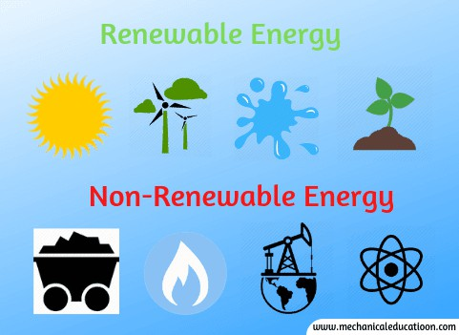
Renewable and Non-renewable Resources
What are renewable resources?
The resources which are renewed or replenished fast or have unlimited source.
Example: Water, air,
biomass, solar energy etc.
What are non-renewable resources?
The resources which can not be renewed or replenished.
Example: Fossil fuels, Nuclear power, Minerals etc.

Slide 6
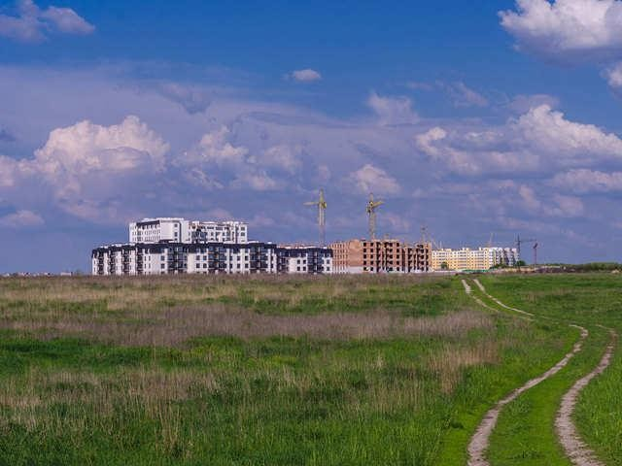
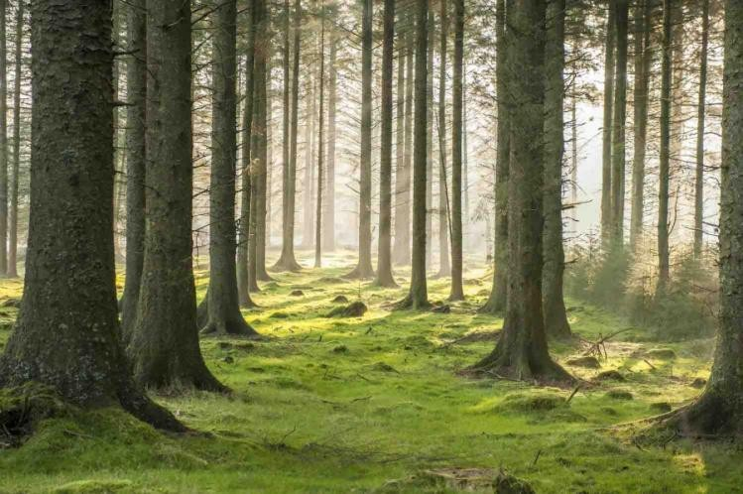
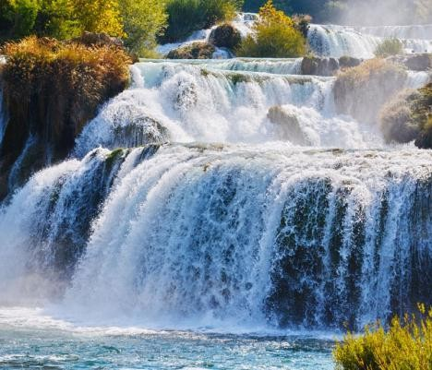
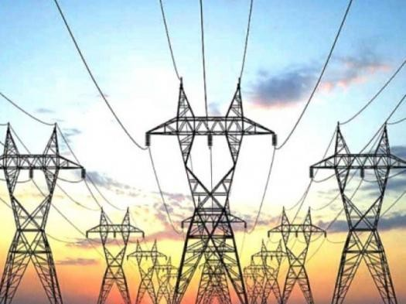
Some natural resources to be discussed
Land Resource
Forest Resource
Water Resource
Energy Resource

Slide 7
LAND RESOURCE
Dr. Prasenjit Adak

Slide 8
Land as a resource
The study of soils in their natural environment is called
“pedology”.
Land is a renewable but limited resource
Problems related to land resource
Reaching the carrying capacity
Population density
Improper land-use planning
Saltwater intrusion
Land degradation
Soil erosion

Slide 9
Land Degradation
Causes
Natural causes
Heavy rainfall
High speed winds
Natural disasters: earthquake, landslide, flood, draught
Expansion of desert
Anthropogenic causes
Mining
Urbanization
Deforestation
Overgrazing
Water logging
Construction of dams
Extensive use of fertilizers
Dumping of industrial and municipal wastes

Slide 10
Soil
Soil is a dynamic natural body capable of supporting a vegetative cover. It is composed largely of weathered rocks, water, oxygen and organic materials.
Soil formation
Processes
Physical weathering
Chemical weathering
Biological weathering
Factors
Parent material
Living organisms
Climate
Topography
Time

Slide 11
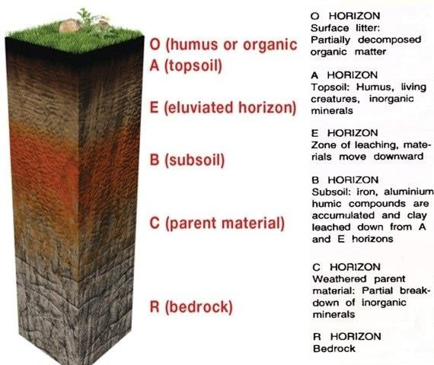
Soil
Soil profile

Slide 12
Soil
Functions of soil
Facilitates nutrient cycle
Food and other biomass production
Stores water and regulates water supply
Regulates the emission of trace gases
Filter ground water
Degrades pollutants
Biological habitat
Source of clay
Platform for man-made structures: buildings, highways

Slide 13
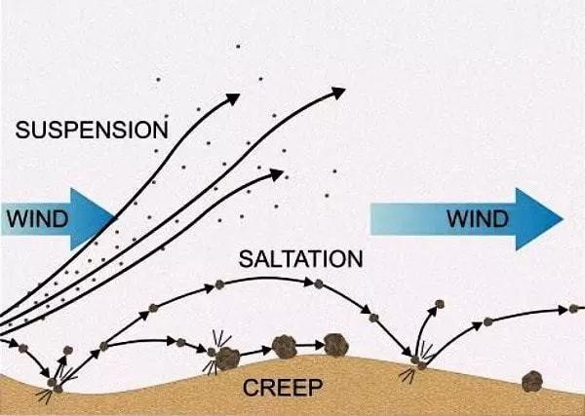
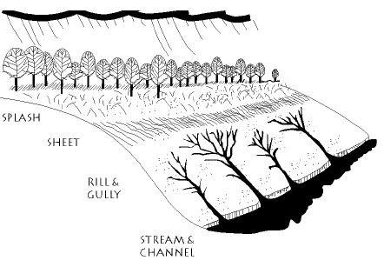
Soil Erosion
Types
Normal erosion or geologic erosion
Accelerated or Anthropogenic erosion
Causes
Climatic agents
Water induced erosion
Splash erosion
Sheet erosion
Rill erosion
Gully erosion
Slip erosion
Stream bank erosion
Wind induced erosion
Suspension
Saltation
Surface creep
Biotic agents

Slide 14
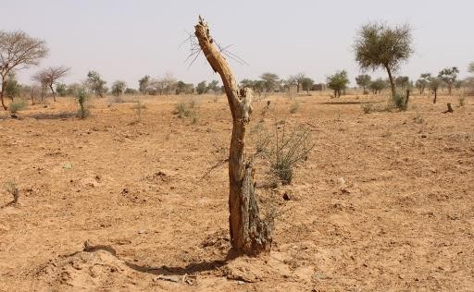
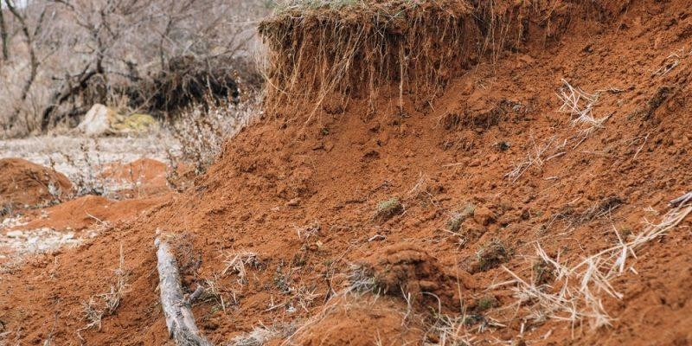
Soil Erosion
Effects
Decreased productivity of land
Desertification of land
Deposition of soil in water bodies
Reduction of agricultural land in river banks

Slide 15
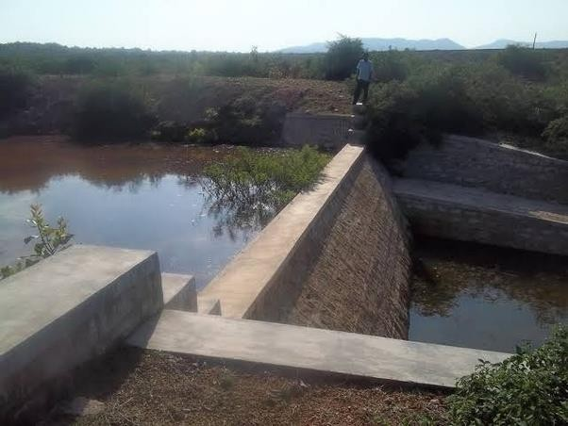
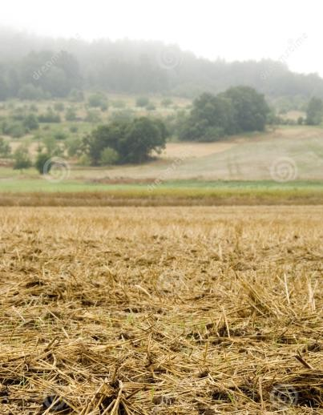
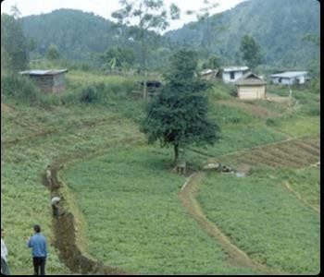
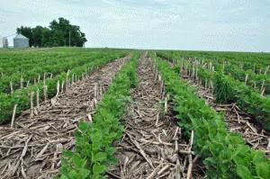
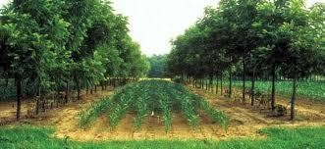
Soil Erosion
Control
Conservational till farming
Stubble mulching
Contour farming
contour bunding
Construction of check
dams
Terracing
Strip cropping
Alley cropping (Agro-
forestry)
Wind breaks

Slide 16
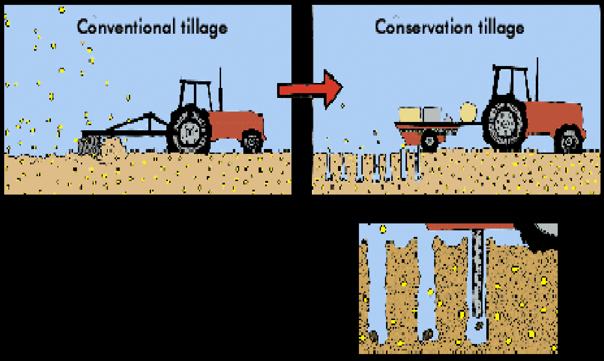
Conventional tillage VS Conservation tillage

Slide 17
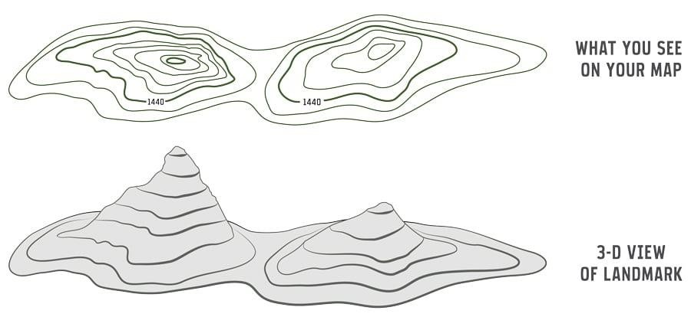
Contour Lines
Contour Lines (lines that connect the points with same altitude)

Slide 18
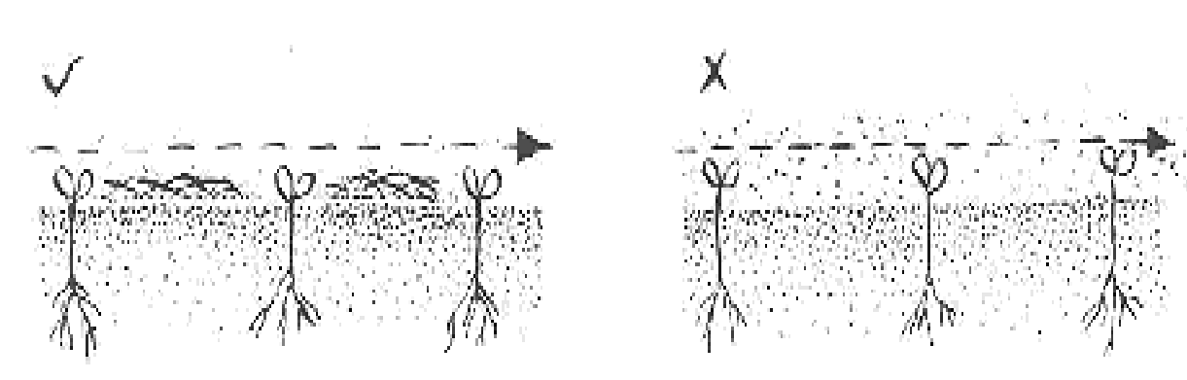
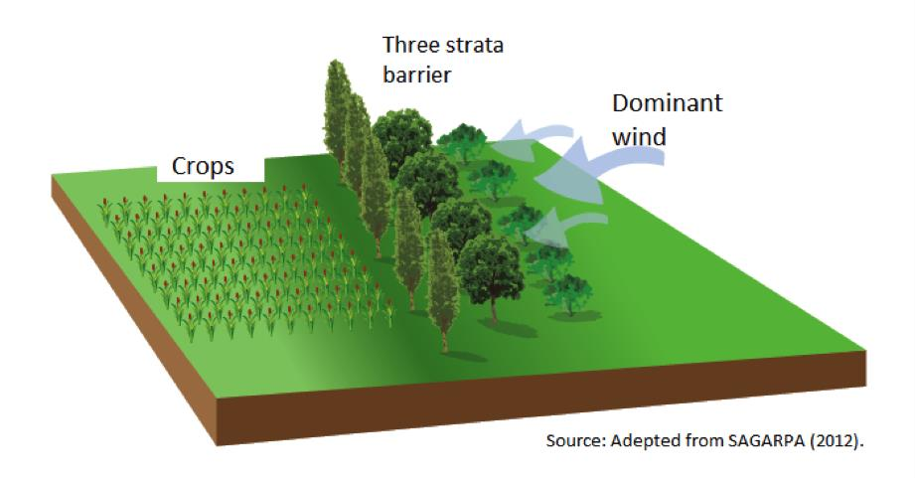
Wind Breaks

Slide 19
Desertification
Types
Moderate (10 - 25%)
Severe (25 – 50%)
Very severe (more than 50%)
Causes
Natural causes
Very low rain fall
Excessive evaporation
Vast difference in diurnal temperature
High salinity
Anthropogenic causes
Deforestation
Overgrazing
Conversion of pasture into arable land
Excessive use of fertilizer

Slide 20
Desertification
Effects
Rapid soil erosion
Poor soil quality
Unfavorable climate
Low water table, salty and hard water
Endangered human and animal life
Economic and human cost

Slide 21
Desertification
Control
Large scale plantation
Sustainable agricultural practices
Development of pasture land and controlling overgrazing
Development of water catchment
Rainwater harvesting

Slide 22
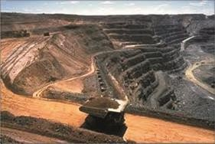
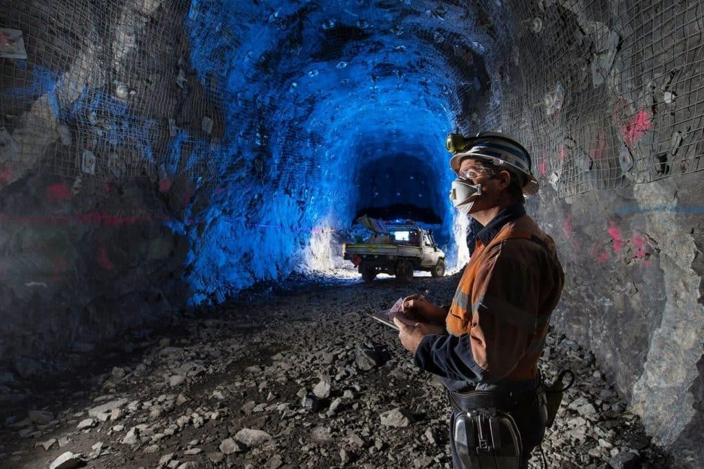
Mining
Mining is the extraction of valuable minerals or other geological materials from the Earth
Opencast Mining
Underground Mining

Slide 23
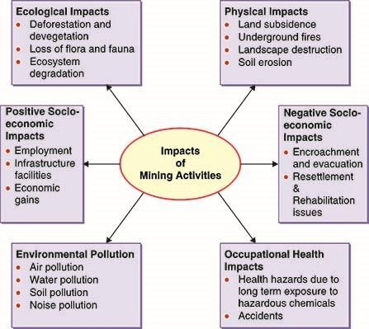
Mining
Effects of Mining

Slide 24
Thank You

